Slide 1
第6章 运算符

Slide 2
课程内容
6.1 算术运算符
6.2 关系运算符
6.3 逻辑运算符
6.4 位运算符
6.5 赋值运算符
6.6 其他运算符
6.7 运算符优先级

Slide 3
6.1 算术运算符

Slide 4
6.1.1 一元运算符
>>> a = 12
>>> -a
-12
>>>

Slide 5
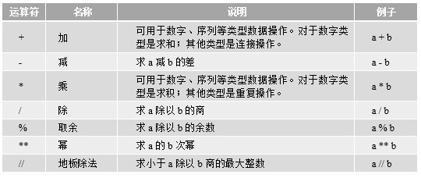
6.1.2 二元运算符

Slide 6
在Python Shell中运行示例代码如下：
>>> 1 + 2
3
>>> 2 - 1
1
>>> 2 * 3
6
>>> 3 / 2
1.5
>>> 3 % 2
1
>>> 3 // 2
1
>>> -3 // 2
-2
>>> 10 ** 2
100
>>> 10.22 + 10
20.22
>>> 10.0 + True + 2
13.0

Slide 7
字符串属于序列的一种，所以字符串可以使用+和*运算符
>>> 'Hello' + 'World'
'HelloWorld'
>>> 'Hello' + 2
Traceback (most recent call last):
File "<pyshell#35>", line 1, in <module>
'Hello' + 2
TypeError: must be str, not int
>>>
>>> 'Hello' * 2
'HelloHello'
>>> 'Hello' * 2.2
Traceback (most recent call last):
File "<pyshell#36>", line 1, in <module>
'Hello' * 2.2
TypeError: can't multiply sequence by non-int of type 'float'

Slide 8
6.2 关系运算符

Slide 9
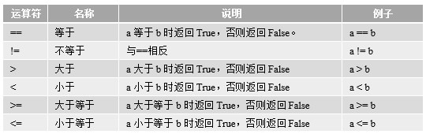
关系运算符

Slide 10
在Python Shell中运行示例代码如下：
>>> a = 1
>>> b = 2
>>> a > b
False
>>> a < b
True
>>> a >= b
False
>>> a <= b
True
>>> 1.0 == 1
True
>>> 1.0 != 1
False

Slide 11
在Python Shell中运行示例代码如下：
>>> a = 'Hello'
>>> b = 'Hello'
>>> a == b
True
>>> a = 'World'
>>> a > b
True
>>> a < b
False
>>> a = [] ①
>>> b = [1, 2] ②
>>> a == b
False
>>> a < b
True
>>> a = [1, 2]
>>> a == b
True

Slide 12
6.3 逻辑运算符

Slide 13
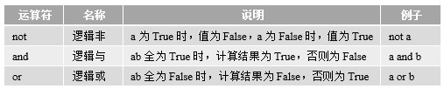
逻辑运算符

Slide 14
# 代码文件：chapter7/7.3/hello.py
i = 0
a = 10
b = 9
if a > b or i == 1:
print("或运算为 真")
else:
print("或运算为 假")
if a < b and i == 1:
print("与运算为 真")
else:
print("与运算为 假")
def f1(): ①
return a > b
def f2(): ②
print('--f2--')
return a == b
print(f1() or f2()) ③

Slide 15
6.4 位运算符

Slide 16
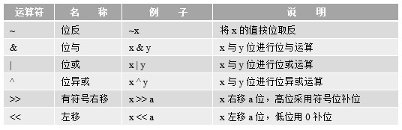
位运算符

Slide 17
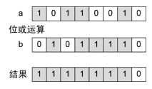
位或运算

Slide 18
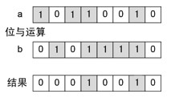
位与运算

Slide 19
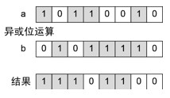
异或位运算

Slide 20
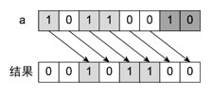
右位移2位运算

Slide 21
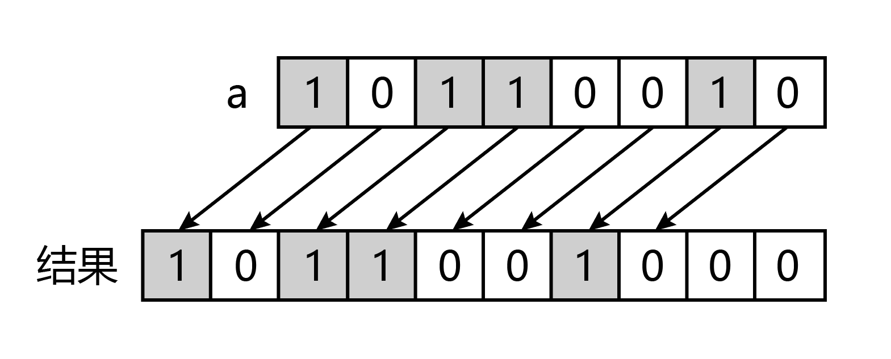
左位移2位运算

Slide 22
6.5 赋值运算符

Slide 23
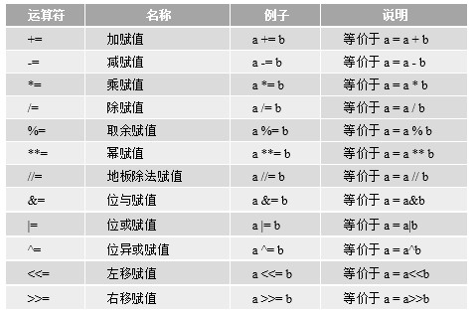
算术赋值运算符

Slide 24
示例代码如下：
# 代码文件：chapter7/7.5/hello.py
a = 1
b = 2
a += b # 相当于a = a + b
print("a | b = {0}".format(a)) # 输出结果3
a += b + 3 # 相当于 a = a + b + 3
print("a + b + 3 = {0}".format(a)) # 输出结果7
a -= b # 相当于a = a - b
print("a - b = {0}".format(a)) # 输出结果6
a *= b # 相当于a = a * b
print("a * b = {0}".format(a)) # 输出结果12
a /= b # 相当于a = a / b
print("a / b = {0}".format(a)) # 输出结果6
a %= b # 相当于a = a % b
print("a % b = {0}".format(a)) # 输出结果0
……

Slide 25
6.6 其他运算符

Slide 26
6.6.1 同一性测试运算符
# coding=utf-8
# 代码文件：chapter7/7.6/ch7.6.1.py
class Person: ①
def __init__(self, name, age):
self.name = name
self.age = age
p1 = Person('Tony', 18)
p2 = Person('Tony', 18)
print(p1 == p2) # False
print(p1 is p2) # False
print(p1 != p2) # True
print(p1 is not p2) # True

Slide 27
修改代码如下：
class Person:
def __init__(self, name, age):
self.name = name
self.age = age
def __eq__(self, other):
if self.name == other.name and self.age == other.age:
return True
else:
return False
p1 = Person('Tony', 18)
p2 = Person('Tony', 18)
print(p1 == p2) # True
print(p1 is p2) # False
print(p1 != p2) # False
print(p1 is not p2) # True

Slide 28
6.6.2 成员测试运算符
# coding=utf-8
# 代码文件：chapter7/7.6/ch7.6.2.py
string_a = 'Hello'
print('e' in string_a) # True ①
print('ell' not in string_a) # False ②
list_a = [1, 2]
print(2 in list_a) # True ③
print(1 not in list_a) # False ④

Slide 29
6.7 运算符优先级

Slide 30
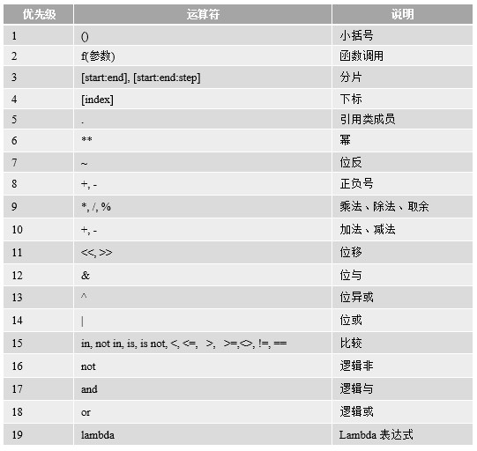
运算符优先级

Slide 31


